Slide 1

DATABASE MANAGEMENT SYSTEM SCSA1301
R.Sethuraman/Dr.Mohana Prasad
Assistant Professor/Associate Professor
Department of Computer science
Sathyabama Institute of science and Technology

Slide 2

COURSE OBJECTIVES
➢ To understand terms related to database design and management.
➢ To gain knowledge in relational model and relational database management system.
➢ To implement relational databases using SQL & My SQL.
➢ To understand database security and performance issues.
➢ To understand the basics of Data warehousing and Data mining

Slide 3
INTRODUCTION TO DATABASES Unit – I
Database Introduction
Database Users
Database concepts
Database Architecture
Data Modeling
Entity Relationship (ER) Modeling
Relational Database management constraints
Relational Algebra and Relational Calculus

Slide 4
Database Introduction
Data Processing:
Data collection
Data Recording
Data Sorting
Data Classifying
Data Calculating Storing & retrieving
Data Summarizing
Data Communicating

Slide 5
Database Introduction
Data Processing modes:
Batch processing:
Transactions are collected in a group & processed together
2. On-line (interactive) processing:
Transactions are processed as & when they appear.
3. Real-time processing:
It is a parallel time relationship with on-going activity & the information produced is useful in controlling the current/dynamic activity

Slide 6
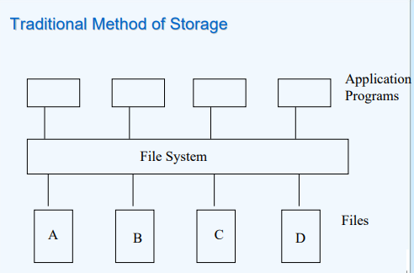
Traditional Method of Storage

Slide 7
Ways of storing data in files
4176 Aniruddha Sarkar SBU1
4181 Manoj Saha SBU1
4183 Moushumi Dharchoudhury SBU1
4203 Suryanarayana D.V.S.S. SBU1
4204 Vivek Rai SBU1
Data used to be stored in the form of records in the files
Records consist of various fields which are delimited by a space , comma , tab etc
There used to be special characters to mark end of records and end of files.

Slide 8
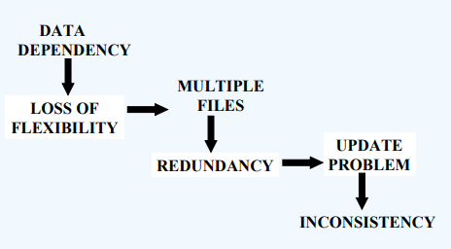
Problems:Traditional approach

Slide 9
The Database Technology
Database Vs Database Management System
Database:
Computer based record-keeping system
Collection of interrelated (persistent) data
Records & maintains data
Database Management System:
Collection of files that contain related data
Managed by a specialized piece of software known as a database
management system (DBMS)
Layer of abstraction between the application programs and the file system

Slide 10
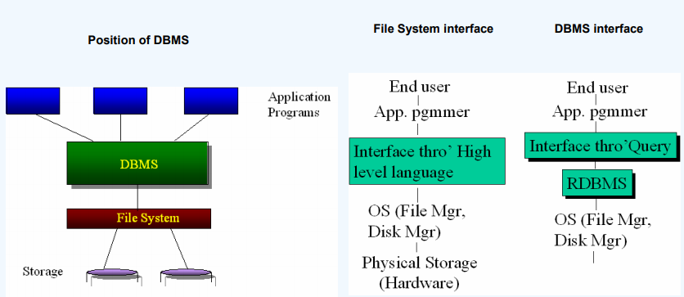
Where does the RDBMS fit in?

Slide 11
Services provided by a DBMS
•Data management
•Data definition
•Transaction support
•Concurrency control
•Recovery
•Security & integrity
•Utilities- facilities like data import & export, user management, backup, performance analysis, logging & audit, physical storage control

Slide 12
Advantages of a DBMS
Data independence
Reduction in data redundancy
Better security
Better flexibility
Effective data sharing

Slide 13
Users of a DBMS
Database Administrator (DBA)
Managing information contents
Liaison with users
Enforcing security and integrity rules
Strategizing backup & recovery
Monitoring performance
II. Database designers
III. Application Programmers
IV. End users

Slide 14
Database Technologies
Hierarchical Model [IMS]
Network Model [IDMS]
Relational Model [Oracle, DB2,Mysql etc]
Object-Oriented [lambda-DB]

Slide 15
Relational Model Basics
Data is viewed as existing in two dimensional tables known as relations
A relation (table) consists of unique attributes (columns) and tuples (rows)
Tuples are unique
Sometimes the value to be inserted into a particular cell may be unknown, or it may have no value. This is represented by a null
Null is not the same as zero, blank or an empty string
Relational Database: Any database whose logical organization is based on relational data model.
RDBMS: A DBMS that manages the relational database.

Slide 16
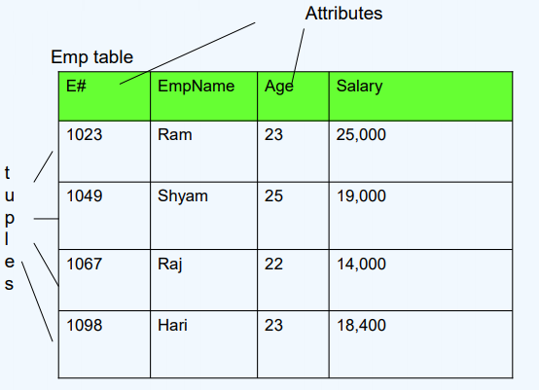
A sample relation

Slide 17
Keys and Constrains
Super key
Candidate key
Primary key
Foreign key
Super key:
An attribute, or group of attributes, that is sufficient to distinguish every tuple in the relation from every other one. Each super key is called a candidate key.
A candidate key is all those set of attributes which can uniquely identify a row. However, any subset of these set of attributes would not identify a row uniquely
For example, in a shipment table, “S# , P# ” is a candidate key. But, S# alone or P# alone would not uniquely identify a row of the shipment table.

Slide 18
Keys and Constrains
Primary key :
The candidate key that is chosen to perform the identification task is called the primary key and any others are alternate keys Every tuple must have, by definition, a unique value for its primary key. A primary key which is a combination of more than one attribute is called a composite primary key.

Slide 19
Keys and Constrains
Foreign key:
A foreign key is a “copy” of a primary key that has been exported from one relation into another to represent the existence of a relationship between them. A foreign key is a copy of the whole of its parent primary key i.e if the primary key is composite, then so is the foreign key
Foreign key values do not (usually) have to be unique
Foreign keys can also be null
A composite foreign key cannot have some attribute(s) null and others non-null

Slide 20
Conceptual design Entity Relationship modeling
Data modeling:
Study of basic properties and inter-relationships among data items to properly represent them in the basic data structures of a database.
Two popular techniques: ER modeling and Normalization

Slide 21
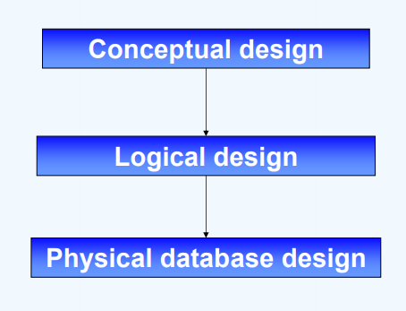
Design levels of a database
The outcome of each stage is correspondingly called the conceptual schema, the database schema and the physical design

Slide 22
ER modeling
ER modeling:
A graphical technique for understanding and organizing the data independent of the actual database implementation
Entity:
Any thing that may have an independent existence and about which we intend to collect data. Also known as Entity type.
Entity instance:
A particular member of the entity type e.g. a particular student.
Attributes:
Properties/characteristics that describe entities
Relationships:
Associations between entities

Slide 23
DATABASE SYSTEM CONCEPTS AND ARCHITECTURE
Data models:
Data model is a collection of concepts that can be used to describe the structure of db.
Categories of Data models:
High level or conceptual data model
Conceptual DM provides concepts that explains the different ways to perceive data and uses the concepts such as entities, attributes and relationships.
Low level or Physical DM:
This will provide the concept of how the data is stored in the computer
Representational or Implementation DM:
This is the intermediate DM between high level and low level
It provides the concepts that may be understood by end users but that are not too far removed from the way data is stored in the computer.(ER-MODEL)

Slide 24
Data Modeling Jargons
Schema or intension:
The description of a database is called the schema or intension.
Instance or occurrences:
Each row in the database i.e. a set of related data’s.
Extension or database state or snapshot:
The data in the database at a particular moment is called database state or extension, which is the current set of instances. At initial state of the database, the database state is said to be empty.

Slide 25
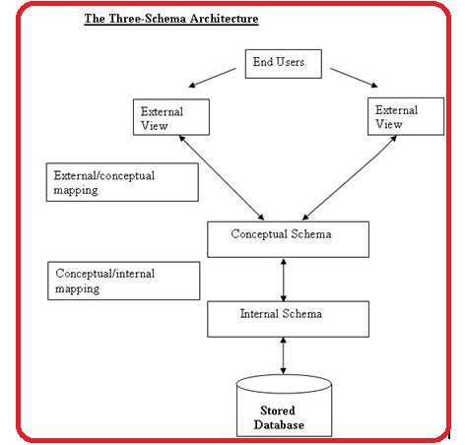
THREE SCHEMA ARCHITECTURE
.
The schemas are defined at three levels :
Internal level or Physical level or Low level
Conceptual level or High level
External level or View level

Slide 26
Data Modeling Jargons
Internal level:
It has an internal scheme, which describes the physical storage structure of the database by means of different data structures link list, queue, stack etc.
It uses a Physical data model.
It is useful for computer scientist.

Slide 27
Data Modeling Jargons
Conceptual Level:
It has a conceptual schema, which describes the structure of the whole database.
It describes data as entities, attributes, & relationships.
It hides the details of physical storage structures.
It uses high-level data model or implementation data model.
It can be understood by end users.

Slide 28
Data Modeling Jargons
Most DBMS do not separate the 3 levels completely but support three schema architecture to some extent. Some DBMS may include internal schema details in the conceptual schema.

Slide 29
E-R MODEL
ENTITY- RELATIONSHIP MODEL (E-R MODEL)
Entity relationship model is a high-level conceptual model, which is useful for end users. An ER model describes data as
Entities
Attributes
Relationships

Slide 30
E-R MODEL
Entities:
An entity is defined as the real world object or thing that is described in the database. Examples: employee, student, department, project.
Attributes:
The set of possible values for an attribute is called the domain of the attribute.
The domain of attribute marital status is just the four values: single, married, divorced, widowed.
The domain of the attribute month is the twelve values ranging from January to December

Slide 31
E-R MODEL
Key attribute: The attribute (or combination of attributes) that is unique for every entity instance
– E.g the account number of an account, the employee id of an employee etc.
If the key consists of two or more attributes in combination, it is called a composite key

Slide 32
E-R MODEL
Single Vs Multi-valued Attributes
Single valued : can take on only a single value for each entity instance
E.g. age of employee. There can be only one value for this
Multi-valued: can take many values:
E.g. skill set of employee

Slide 33
E-R MODEL
Stored Vs Derived attribute:
Stored Attribute: Attribute that need to be stored permanently.
E.g. name of an employee
Derived Attribute: Attribute that can be calculated based on other attributes
E.g. : years of service of employee can be calculated from date of joining and current date

Slide 34
E-R MODEL
Regular Vs. Weak entity type:
Regular Entity: Entity that has its own key attribute.
E.g.: Employee, student ,customer, policy holder etc
Weak entity: Entity that depends on other entity for its existence and doesn’t have key attribute of its own
E.g. : spouse of employee

Slide 35
E-R MODEL
Relationships:
A relationship type between two entity types defines the set of all associations between these entity types
Each instance of the relationship between members of these entity types is called a relationship instance
E.g if Works-for is the relationship between the Employee entity and the department entity, then Ram works for Comp.sc department, shyam works –for electrical department ..etc are relationship instances of the relationship, works-for

Slide 36
E-R MODEL
Degree of a Relationship:
Degree: the number of entity types involved
• One Unary
• Two Binary
• Three Ternary
E.g employee manager-of employee is unary employee works-for department is binary customer purchase item, shop keeper is a ternary relationship

Slide 37
E-R MODEL
Cardinality:
Relationships can have different connectivity
– one-to-one (1:1)
– one-to-many (1:N)
– many-to-many (M:N)
E.g employee head-of department (1:1) student enrolls course (m:n) lecturer offers course (1:n) assuming a course is taught by a single lecturer.
The minimum and maximum values of this connectivity is called the cardinality of the relationship

Slide 38
E-R MODEL
Relationship Participation:
Total : Every entity instance must be connected through the relationship to another instance of the other participating entity types
Partial: All instances need not participate
E.g Employee Head-of Department Employee: partial Department: total

Slide 39
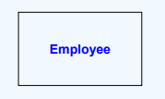
ER modelling -Notations
Entity:
Usually a noun in singular
Represented by a rectangle with a label
First letter in capitals

Slide 40
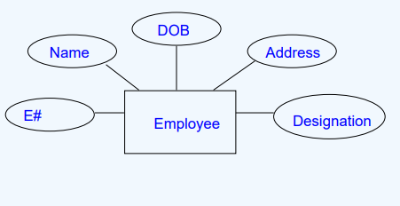
ER modelling -Notations
Attributes:

Slide 41
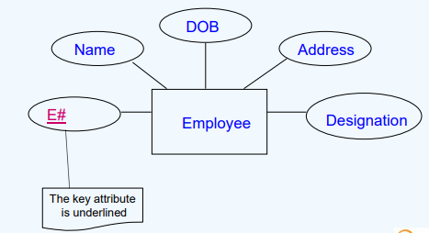
ER modelling -Notations
Key Attributes:

Slide 42
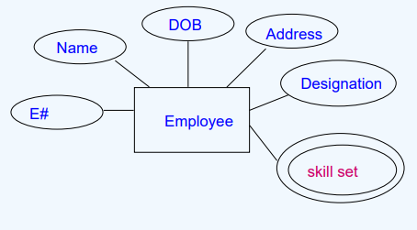
ER modelling -Notations
Multivalued Attribute :
Indicated by a double lined ellipse as shown in the figure

Slide 43
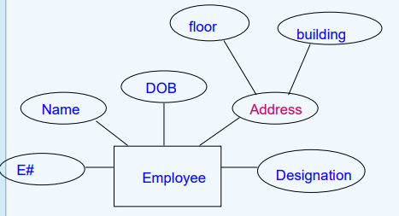
ER modelling -Notations
Composite attribute:
Represented by an ellipse from which other ellipses emanate and represent the component attributes. E.g Address

Slide 44
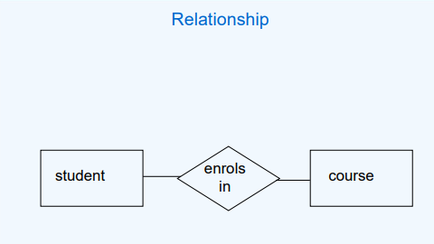
ER modelling -Notations
Relationship:
A relationship is represented as a diamond between two entity types
The relationship above is read as student enrolls-in course

Slide 45
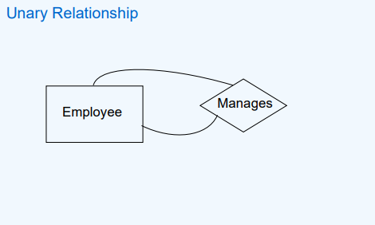
ER modelling -Notations
Unary Relationship:
A unary relationship is represented as a diamond which connects one entity to itself as a loop
The relationship above means, some instances of employee manage other instances of Employee

Slide 46
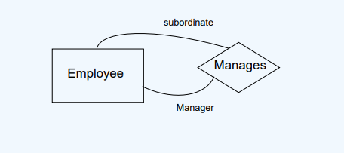
ER modelling -Notations
Role names:
Role names may be added to make the meaning more explicit

Slide 47
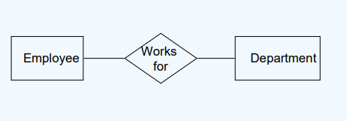
ER modelling -Notations
Binary Relationship:
A relationship between two entity types

Slide 48
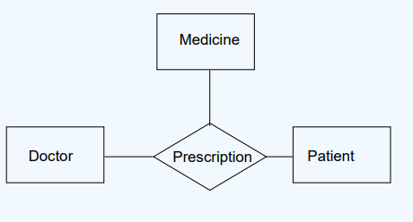
ER modelling -Notations
Ternary Relationship :
A relationship connecting three entity types.

Slide 49
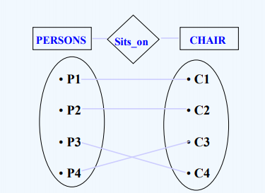
ER modelling -Notations
1:1 relationship :
One instance of entity type 1 is connected to exactly one other entity instance of entity type 2

Slide 50
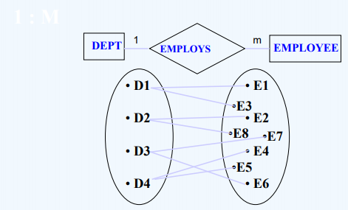
ER modelling -Notations
1:m relationship :

Slide 51
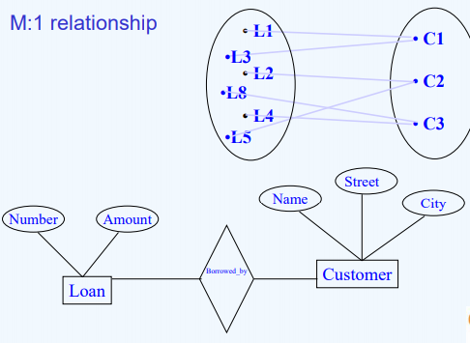
ER modelling -Notations
M:1 relationship :

Slide 52
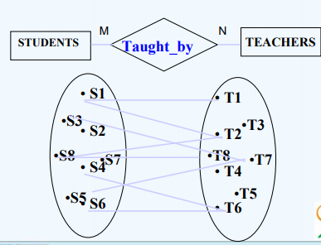
ER modelling -Notations
M:N relationship :

Slide 53
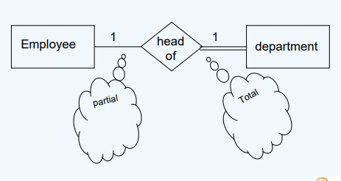
ER modelling -Notations
Relationship participation:
All instances of the entity type Employee don’t participate in the relationship, Head-of.
Every employee doesn’t head a department. So, employee entity type is said to partially participate in the relationship.
But, every department would be headed by some employee.
So, all instances of the entity type Department participate in this relationship. So, we say that it is total participation from the department side.

Slide 54
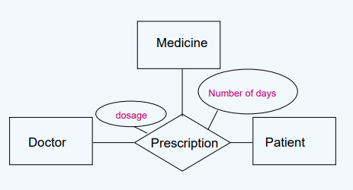
ER modelling -Notations
Attributes of a Relationship:

Slide 55
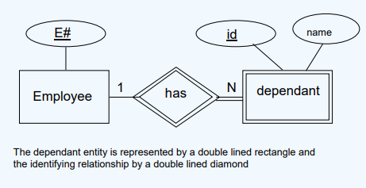
ER modelling -Notations
Weak entity:

Slide 56
Summary
The file based approach has problems of redundancy, inconsistency etc
The Database model consists of three layers
RDBMS handles data in the form of relations, tuples and fields
Keys identify tuples uniquely
ER modeling is a diagrammatic representation of the conceptual design of a database
Entity types represent things
Entity type could be strong or weak
Attributes represent characteristics.
Attributes can be simple/composite, single valued/multivalued, stored/derived
Relationship types represent collaboration between entity types.
Relationships could be unary/binary/ternary
Cardinality of relationships could be 1:1, 1:M, N:M

Slide 57
Case study
A banking scenario
• Banks have customers.
• Customers are identified by name, custid, phone number and address.
• Customers can have one or more accounts
• Accounts are identified by an account number, account type (savings, current) and a balance.
• Customers can avail loans.
• Loans are identified by loan id, loan type (car, home, personal)
• and an amount.
• Banks are identified by a name, code and the address of the main office.
• Banks have branches.
• Branches are identified by a branch number, branch name and an address.
• Accounts and loans are related to the banks’ branches.
• Create an ER diagram for a database to represent this application

Slide 58
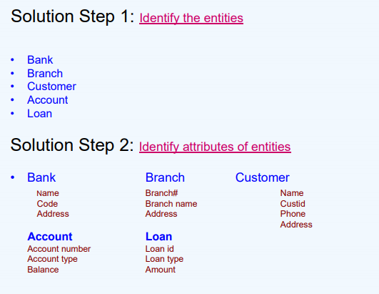
Case study

Slide 59
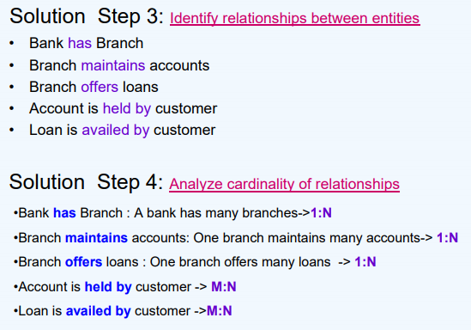
Case study
Notes:
one account may be held by many customers (joint accounts) and one customer may hold many accounts->
One loan may be availed by many customers (joint holders) and one customer may avail many loans (car, housing etc)

Slide 60
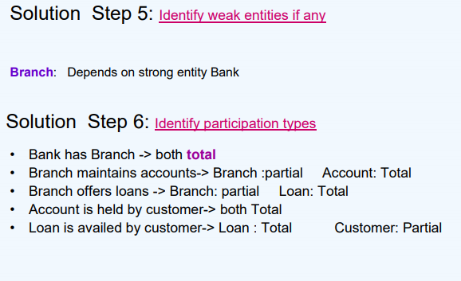
Case study

Slide 61
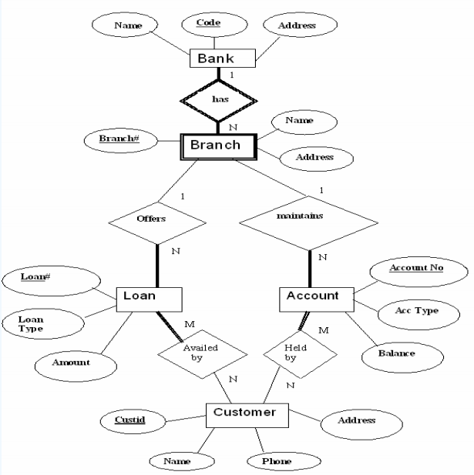
Case study
Notes:
An ER diagram is typically read top to bottom and left to right

Slide 62
Logical database design Converting Er Diagrams To Relational Schema
Logical database design
Process of converting the conceptual model into an equivalent representation in the implementation model (relational/hierarchic/network etc.) We will focus on the relational model.
Relational database design
Convert ER model into relational schema (a specification of the table definitions and their foreign key links)
There are well defined rules for this conversion
Notes:
An ER diagram is typically read top to bottom and left to right

Slide 63
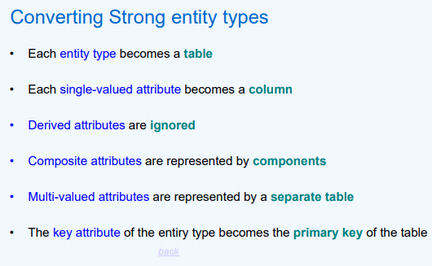
Logical database design Converting Er Diagrams To Relational Schema
6 Rules to Converting Er Diagrams To Relational Schema
Notes:
An ER diagram is typically read top to bottom and left to right

Slide 64
RELATIONAL ALGEBRA OPERATIONS
Relational algebra is a procedural query language, which takes instances of relations as input and yields instances of relations as output. It uses operators to perform queries. An operator can be either unary or binary. They accept relations as their input and yield relations as their output. Relational algebra is performed recursively on a relation and intermediate results are also considered relations.
The fundamental operations of relational algebra are as follows −
SELECT
PROJECT
RENAME
SET OPERATIONS LIKE
UNION
INTERSECTION
SET DIFFERENCE
JOIN
DIVISION
Notes:
An ER diagram is typically read top to bottom and left to right

Slide 65
BASIC RELATIONAL ALGEBRA OPERATIONS
SELECT
Example 1: Select the employees with dno 4
Ans.: σ_{dno=4} (EMPOYEE)
PROJECT OPERATION:
The PROJECT operation is used to select certain set of attributes from a relation. I.e. it selects some of the columns from the table.
Syntax: π _{<attribute list>} (R)
NAME | SSN | BDATE | ADDRESS | SEX | SALARY | DNO
Mani | 384 | 29-12-78 | Chennai | M | 17000 | 4
Notes:
An ER diagram is typically read top to bottom and left to right

Slide 66
BASIC RELATIONAL ALGEBRA OPERATIONS
Example 4: List each employee’s name and salary.
Ans.: π _{name, salary} (EMPOYEE)
NAME | SALARY
Alex | 20000
Siva | 15000
Sruthi | 17000
Gayathri | 14000
Mani | 17000
Notes:
An ER diagram is typically read top to bottom and left to right

Slide 67
BASIC RELATIONAL ALGEBRA OPERATIONS
SET OPERATIONS:
Set operations are used to merge the elements of two sets in various ways including UNION, INTERSECTION, and SET DIFFERENCE.
The three operations UNION, INTERSECTION, and SET DIFFERENCE can be applied on two union compatible relations.
What is a union compatible relation?
Two relations are said to be union compatible relation if they have same degree n (same no of attributes) and that each pair of corresponding attributes have the same domain.
Notes:
An ER diagram is typically read top to bottom and left to right

Slide 68
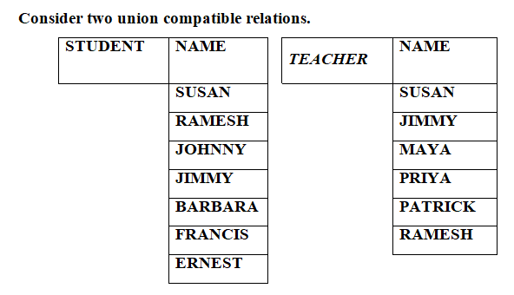
BASIC RELATIONAL ALGEBRA OPERATIONS
Notes:
An ER diagram is typically read top to bottom and left to right

Slide 69
BASIC RELATIONAL ALGEBRA OPERATIONS
UNION:
R ∪ S where R, S are two relations. The result is also a relation that includes all tuples that are either in R or in S or in both R and S.
INTERSECTION:
R ∩ S where R, S are two relations. The result is also a relation that includes all tuples that are in both R and S.
SET DIFFERENCE:
R – S The result is also a relation that includes all tuples that are in R but not in S.
Notes:
An ER diagram is typically read top to bottom and left to right

Slide 70
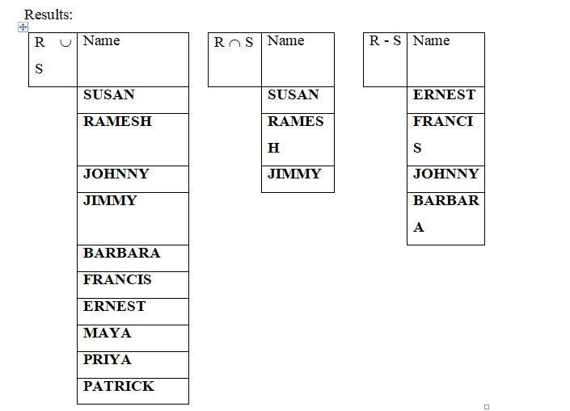
BASIC RELATIONAL ALGEBRA OPERATIONS

Slide 71
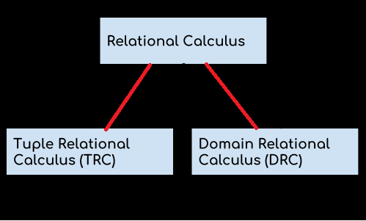
DBMS Relational Calculus
we discussed Relational Algebra which is a procedural query language. Now , we will discuss Relational Calculus, which is a non-procedural query language.
Relational calculus is a non-procedural query language that tells the system what data to be retrieved but doesn’t tell how to retrieve it.
Types of Relational Calculus

Slide 72
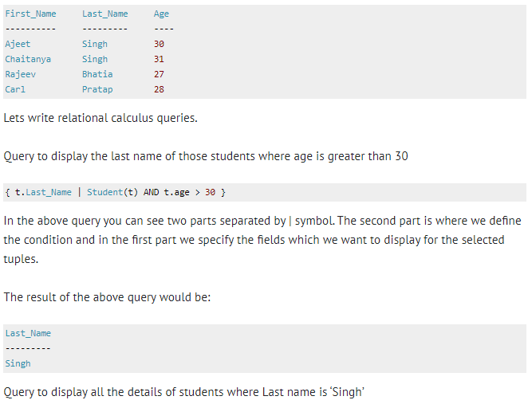
DBMS Relational Calculus
Tuple Relational Calculus (TRC)
Tuple relational calculus is used for selecting those tuples that satisfy the given condition.Table: Student

Slide 73
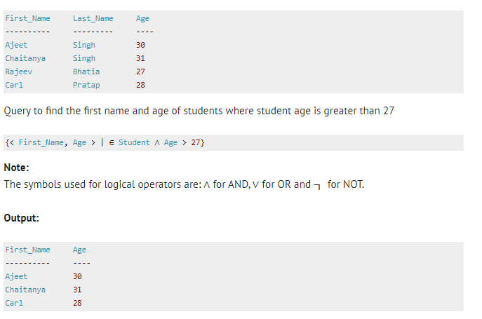
DBMS Relational Calculus
Domain Relational Calculus (DRC)
In domain relational calculus the records are filtered based on the domains.

